Slide 1
Insurance Analytics and Applications
16th Insurance Conference
June 2023

Slide 2
Agenda
1
With you today
2
EY at Insurance industry
3
Analytics & AI Insurance Use Cases

Slide 3
01
With you today

Slide 4
With you today
Nikolaos Kefallinos - Senior Manager, Insurance Business Consulting, P&C Leader
Eirini Spyropoulou - Senior Manager, Technology Consulting

Slide 5
02
EY at Insurance Industry

Slide 6
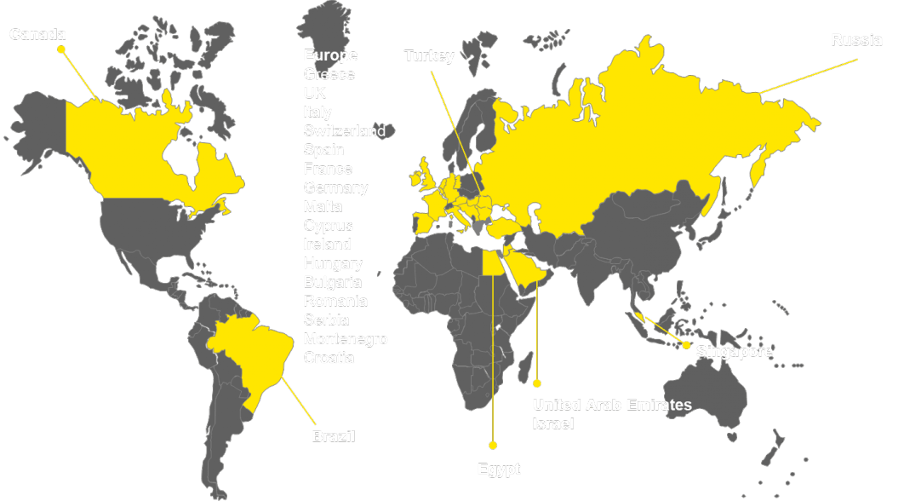
EY Overview | Insurance Consulting
insurance professionals forming a multi-disciplinary team (of actuarial, risk, finance, IT resources) specialized in the insurance industry
We provide a wide spectrum of services
300+
Insurance & actuarial practice in Greece is the largest in CESA region
Supervisory Authority
Regulatory Compliance
Financial Modelling
Financial Reporting
Non - Life Business
Audit and Assurance
Insurance Analytics
Employee Benefits
Health & Operations
Transaction
EY has been ranked as #1 in the HFS Top 10 Insurance Services 2022 report, placing us ahead of 17 other global insurance services providers.
The report highlights that EY was selected because of our strong mix of experience and capabilities across consulting, managed services, finance, and regulations, positioning us uniquely to help insurance clients navigate challenges across every phase of their transformation journey.
40+
countries globally in which EY Greece offers business consulting services in insurance
Our global network of support
We have in-depth knowledge of the accounting, regulatory and tax environment in most countries.
This allows us to accelerate core support within our local teams and bring insights that are specific to each local markets.
Over 136 Insurance Publications released in 2021/22
We serve 97% of the insurance companies on the 2022 Forbes Global 2000
and over 99% of the insurance companies on the 2022 Fortune Global 500

Slide 7
EY Overview | Data, Analytics and AI Center of Excellence in Greece
Key Services we offer
250+
professionals experienced
in Analytics, Business Intelligence and Data Management
Types of Analytics
Sectors served
Strategy & Architecture
We help our clients to define, plan, and realize their Information Management Strategy
Data Foundation & Integration
We help our clients to perform Information Management throughout the data lifecycle
Customer
Commercial
Operational
Finance
Risk
People
Cyber
Banking
Consumer Products
Energy
Insurance
Oil & Gas
Pharma
Retail
Telco
30+
countries globally in which EY Greece has helped clients improve performance with Analytics.
Analytics
We help our clients review and analyze their datasets to produce actionable insights
Artificial Intelligence
Solutions for NLP, Computer Vision, Forecasting, CyberSecurity, Strategic Planning problems
25+
PhDs
Data Usage - Business Intelligence
We help our clients realize the potential of their data through effective reporting enablement. Services range from discrete projects through to full implementation
Asset building
Consumer Commercial Analytics Platform
EY Net Optimizer
Change Insights
Smart Assets
Mobility Pathway
Data Quality and Metadata tool
EY Wavespace in Greece
Leading Banks
Global FMCG Leader
Leading Bank
Global FMCG Leader
Global FMCG Leader
Leading chemicals manufacturer
10%
3%
€1,6m
3-5%
€180m
€116m
Cost reduction from branch optimization while putting less than 1% of the business at risk
Profit improvement after resetting retailer prices due to Brexit announcements
Annual cost savings from call centre operations
Improvement in Net Revenue in Year 1 from optimized promotional spend
Trade investment savings
Annual cost savings in Opex

Slide 8
03
Analytics & AI Insurance Use Cases

Slide 9
Insurance Customer Lifetime Value (i-CLV)
Define profitable vs non profitable customer profiles in conjunction with existing metrics (regulatory or internal)
Customer Profitability
Earmark specific customers or segments to target based on estimated propensity to up-sell/ cross-sell
Gauge value of a given customer/ customer group over time, enabling segmentation of clientele and composition of distinct action plans for each group and/or individual. CLV will utilize and build on IFRS17 work to ensure consistency between financial and marketing metrics.
CLV in conjunction with advanced analytics helps Insurers to gain insights on certain life events, to optimize the outcomes across different functions ² under a uniform view for product opportunities.
Underpenetrated customers/group of customers can be identified to whom certain campaigns and product offerings can be made. It can also lead to the creation of personalized multi-insurance products to address customer needs holistically.
² e.g. actuaries, product development, marketing, risk
Customer retention
Upselling/ Cross selling
Customer
Lifetime
Value
(i-CLV)
Identify customers with the best
retention rate
Manage acquisition spending
CLV can be used to pinpoint and strengthen the relationship with their most profitable customers and identify those who are likely to disengage. A list of actions can be created based on the CLV value of the customer to increase retention rate
CLV enables Insurers to identify which customers are not likely to bring in enough revenue relative to acquisition cost and avoid unnecessary spending.it can also be used to increase Bancassurance penetration by better customer targeting
Cost optimization
CLV enables Insurers to see their customers through the prism of a profitable long-term relationship and in parallel gauge the impact of certain actions

Slide 10
Insurance Customer Analytics
Customer 360º view
Analytics
Challenges we address
Customer data
Analytics for structured data:
Customer segmentation
Propensity models
Analytics for unstructured data:
Sentiment analysis
Topic detection
Text classification
Causal analysis
Entity extraction
Optimization of target market strategy
Effective engagement with customers
Analysis of product performance
Value for future products/services
Identification of drivers for customer satisfaction
Predicting customer churn
Claims data
Call-center data
Chatbot data
Survey data
Social media data
Complaints data

Slide 11
Motor Claims Automation with AI
1
2
Motor Claims Validation
3
Motor Claim Cost Estimation
4
Motor Claims
Classification
Communication Drafting
Automatic classification of incoming claims based on:
the photos
the textual description of the accident
Automatic check of the validity of the claim based on:
the photos
the textual description of the accident
the forms/documents filled in by the police
Automatic estimation of the value of the claim based on:
the photos
the textual description of the accident
historical data of damage valuation
Automatic client communication drafting (email/text message) based on:
information about the claim and its resolution
instructions on the style of the communication, what needs to be included (prompts)

